Slide 1

Field Safety, Security and Emergency Management Document System
Resilience Resource Portal

Slide 2

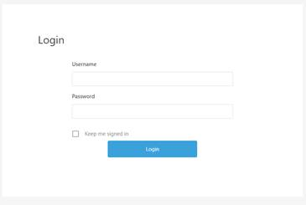
Login for Portal
SITE LINK: https://resilienceresourceportal.com/
USERNAME: partners.user01
PASSWORD: POA224C
When you click on the site link you will see a sign-in page:
You just need to type in your username and password to gain access. It is suggested that you save the link as a ‘favorite’, and also save the password by clicking “keep me signed in” so that the next time you want to access the site you can just click the link and gain immediate access.
All content can be viewed by clicking the “Open” button on each page.

Slide 3
Field Security and Emergency Document System
This multi-language field security and emergency management document system is designed to enable the quick and painless development of scalable security risk management standards and practices at a global level
The system is aligned to ISO and BSI standards to ensure it is effective, as well as to provide organizational litigation and reputational protection – it is built on a decade + of experience in security risk and emergency management in 75+ countries
There are 3 types of security document system:
International travelers or singleton residential roles (ISSEMP USN/TCN)
Host nation singleton or small local national teams (ISSEMP HCN)
Larger programs – with scalable solutions (SSEMP)
The documents in are both PASSIVE (requiring no changes from you – offering best practice) and ACTIVE (requiring input and decisions from you) formats. Passive best practice guidance is offered in all documents as an educational resource

Slide 4
Key Points
The cloud-based portal holds all templates – save the URL link and password as a ‘favorite’
Read the Document Register to know what is in the system
Not all documents will apply immediately – select those you know you need
Use the video tutorials to help you understand and personalize your documents
You can load organizational logos and visuals into sections of the interactive PDFs
Documents come as open word, interactive PDF, closed PDF, excel and PPTs
The Emergency Action Plan must be loaded annually (it expires 31st December every year)
Some documents can be developed as baseline documents and then defined for use (e.g., HRE)
If parts of a document do not relate to you then ignore these sections (a global design)
You should use relevant documents during emergency management team exercising
Documents can be used as educational resources
Keep your inputs succinct where possible – you can have (and reference) supplemental materials
The SSEMP Guide can be used as the overarching ‘parent plan’ for your document system – including across multiple country plans

Slide 5
The process
Familiarize yourself with the cloud-based portal and save the link as a ‘favorite’
Select those documents you need – including the Emergency Action Plan
Watch the associated video tutorials – ask for additional support as needed
Build your emergency mapping using the PPT
Develop your plans and imagery
Validate all data and ask for a final review from your security expert
Review the document system annually (use the template provided) to ensure it is fit for purpose
Check for new documents and languages – this system will continue to grow
Also:
Use the documents to raise individual and group knowledge
Incorporate the documents into emergency management exercising or critical event planning
Always use your documents during an emergent or occurring emergency

Slide 6
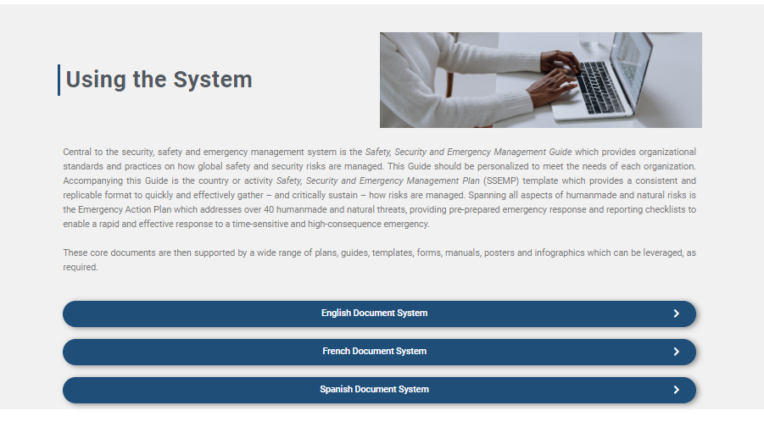
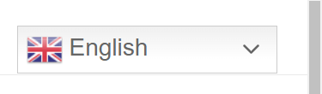
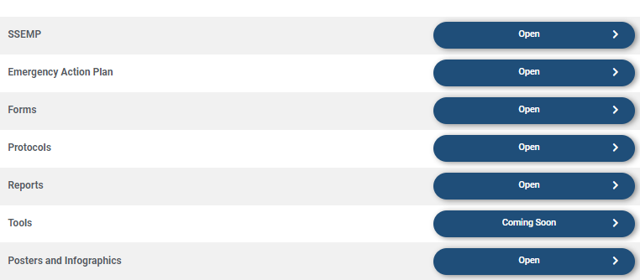
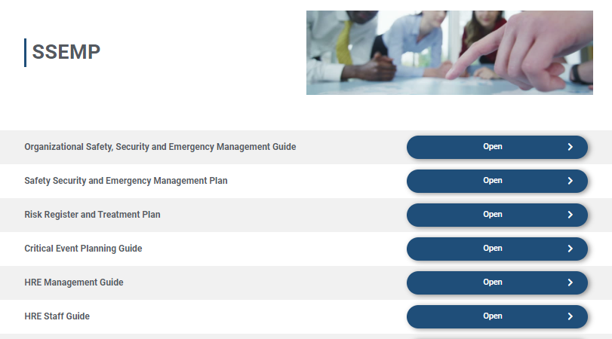
Click on the language drop-down button on the top bar to read the page in your language – then select your language for the documents by clicking the BLUE BUTTON
Click on thematic area – you can use the Document Register to find the document you need
Click ‘open’ BLUE BUTTON and it will download the document onto your laptop or device: check your download folder and then move the document to where you need to store and use it

Slide 7
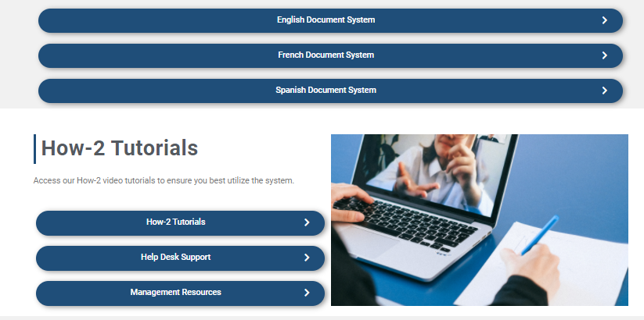
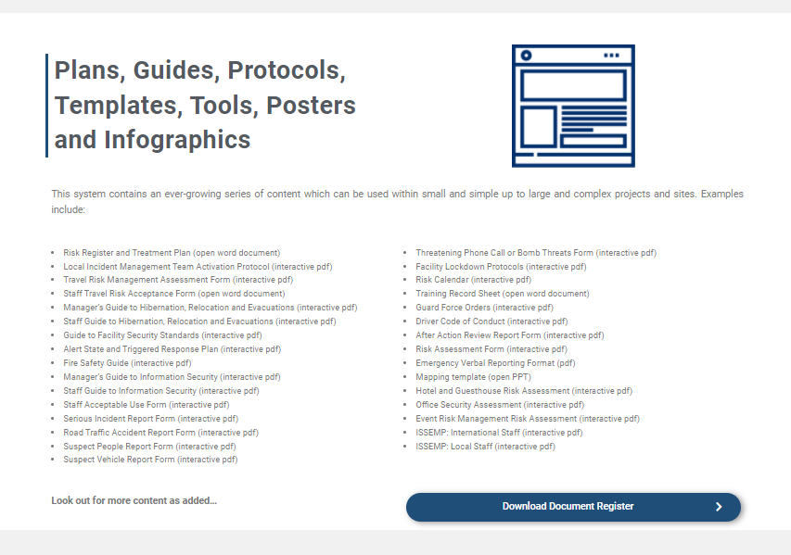
Watch the “How2” videos if you need extra help – leverage other training resources as available
Use the ‘Management Resources’ section to help with internal briefings, the launch and sustainment of the system, and for bids and proposal technical narratives
Check out the list of available documents and download the Document Register for a full list and explanation of each document

Slide 8


